Slide 1
TMDb Data Mining
CZ4032 Data Analytics and Mining, Assignment Representation
Li Bingzi, Wu Ziang, Zhang Shengjing and Zhang Yuehan

Slide 2
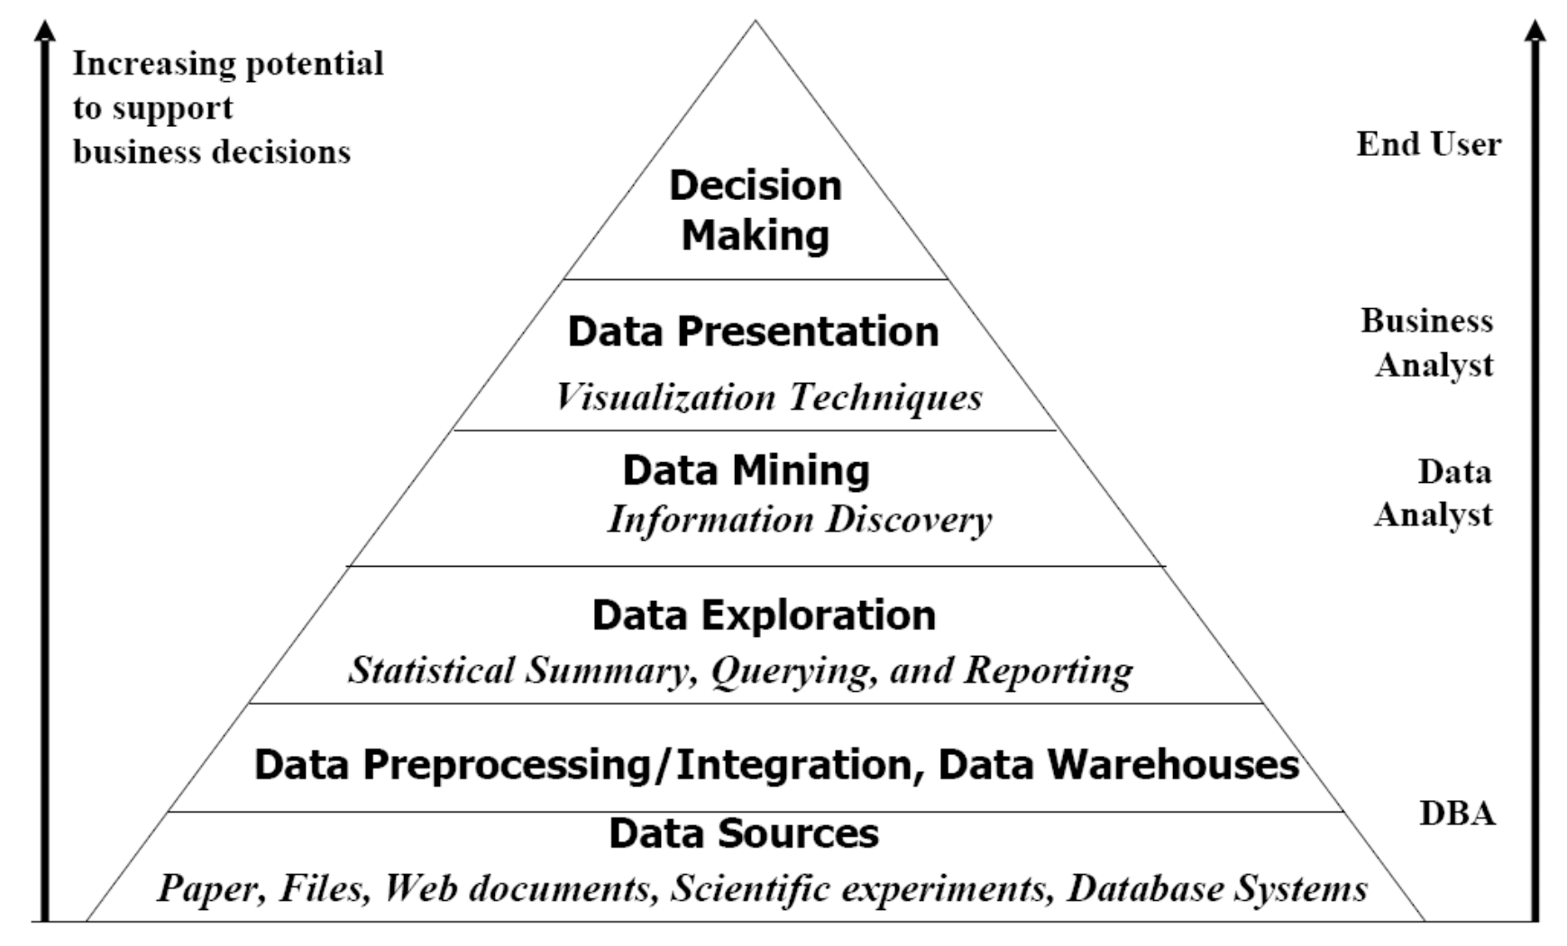
Motivation

Slide 3

Motivation

Slide 4
Problem
understand the correlation between cast, crew, popularity, vote rate and other attributes
predict the success of a movie before released
recommend movies based on their similarity

Slide 5

Pre-processing

Slide 6
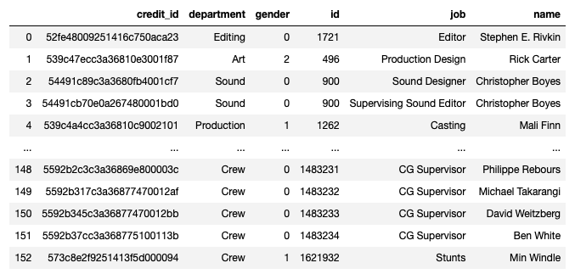
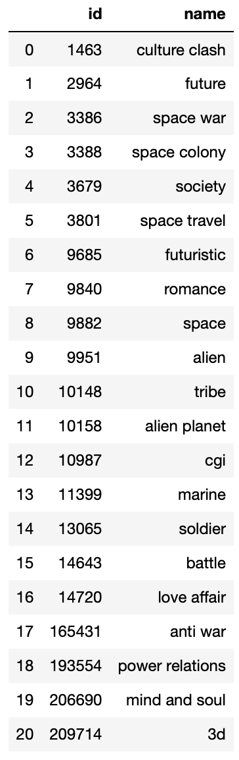

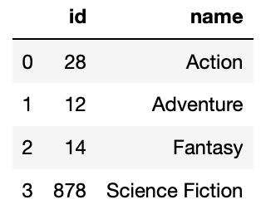
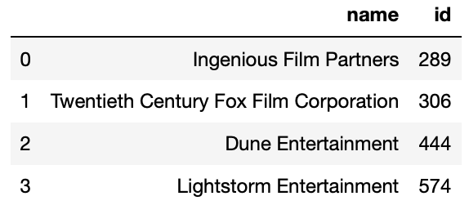
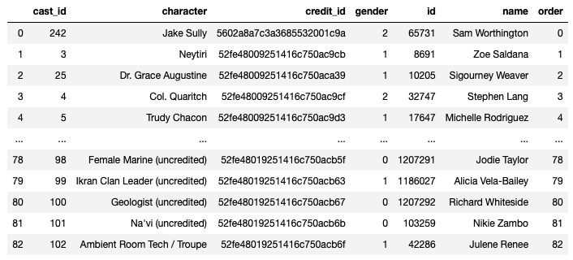
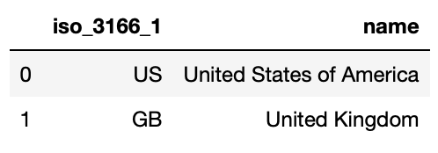
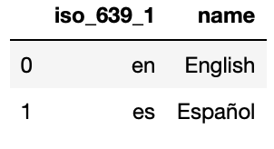
Pre-processing

Slide 7
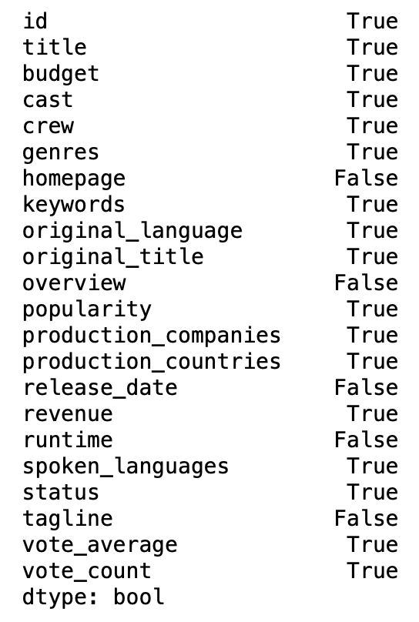
Pre-processing

Slide 8
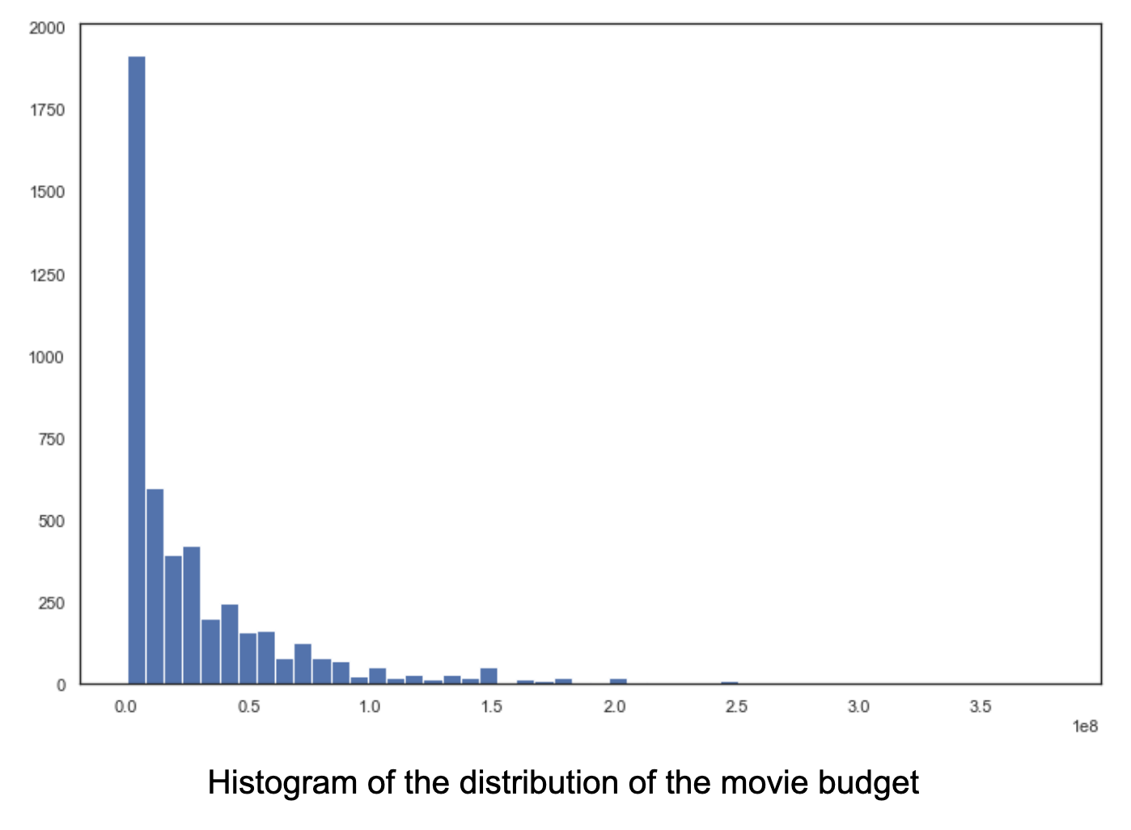
Pre-processing

Slide 9

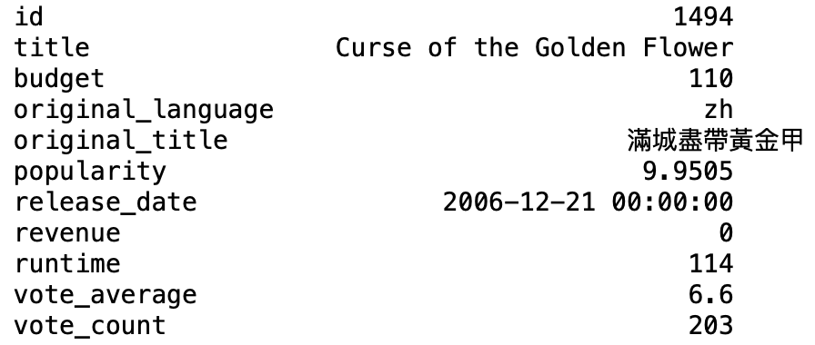
Pre-processing

Slide 10
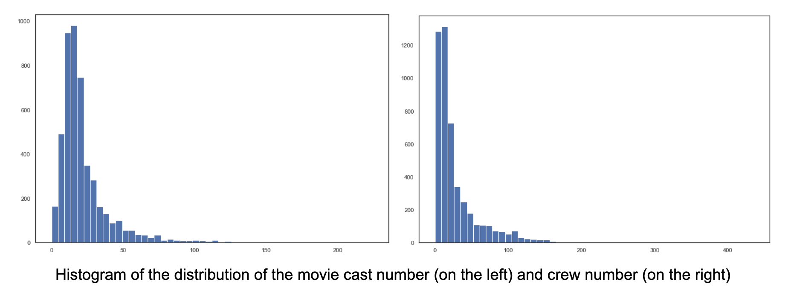
Pre-processing

Slide 11
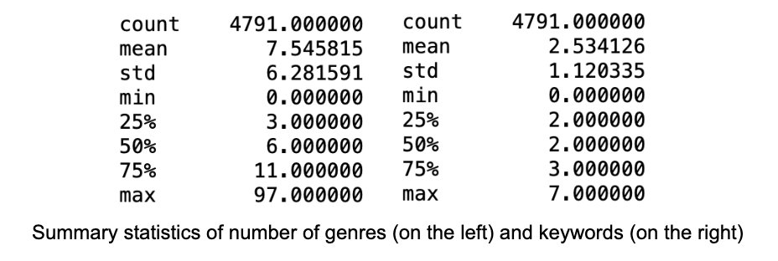
Pre-processing

Slide 12
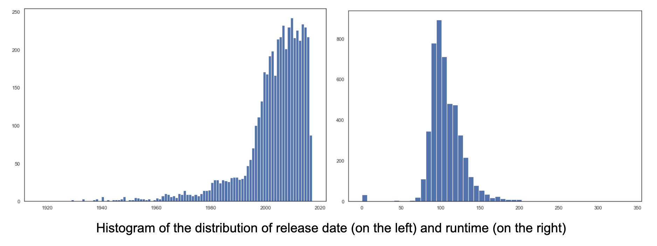
Pre-processing

Slide 13
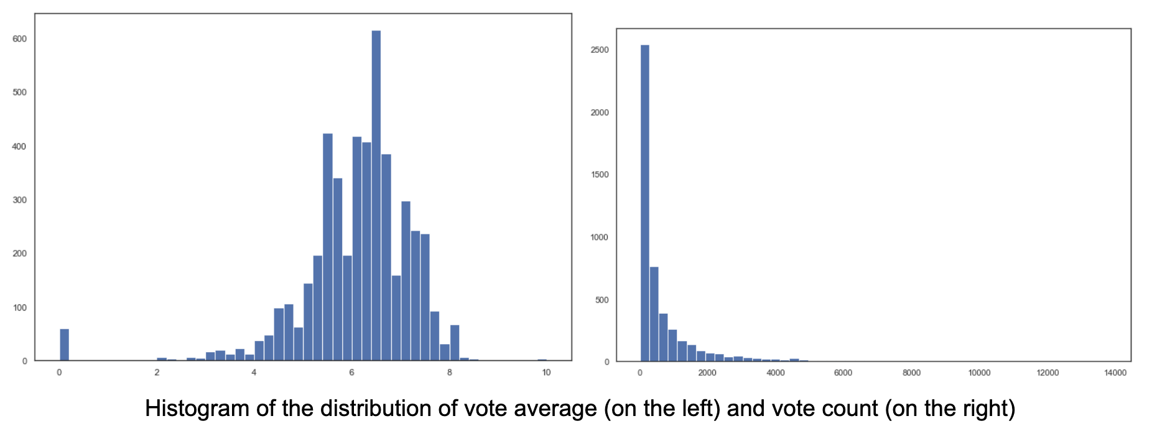
Pre-processing

Slide 14
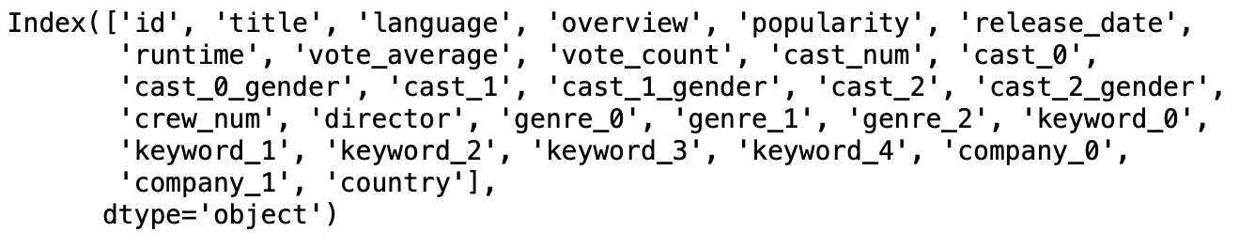
Features

Slide 15
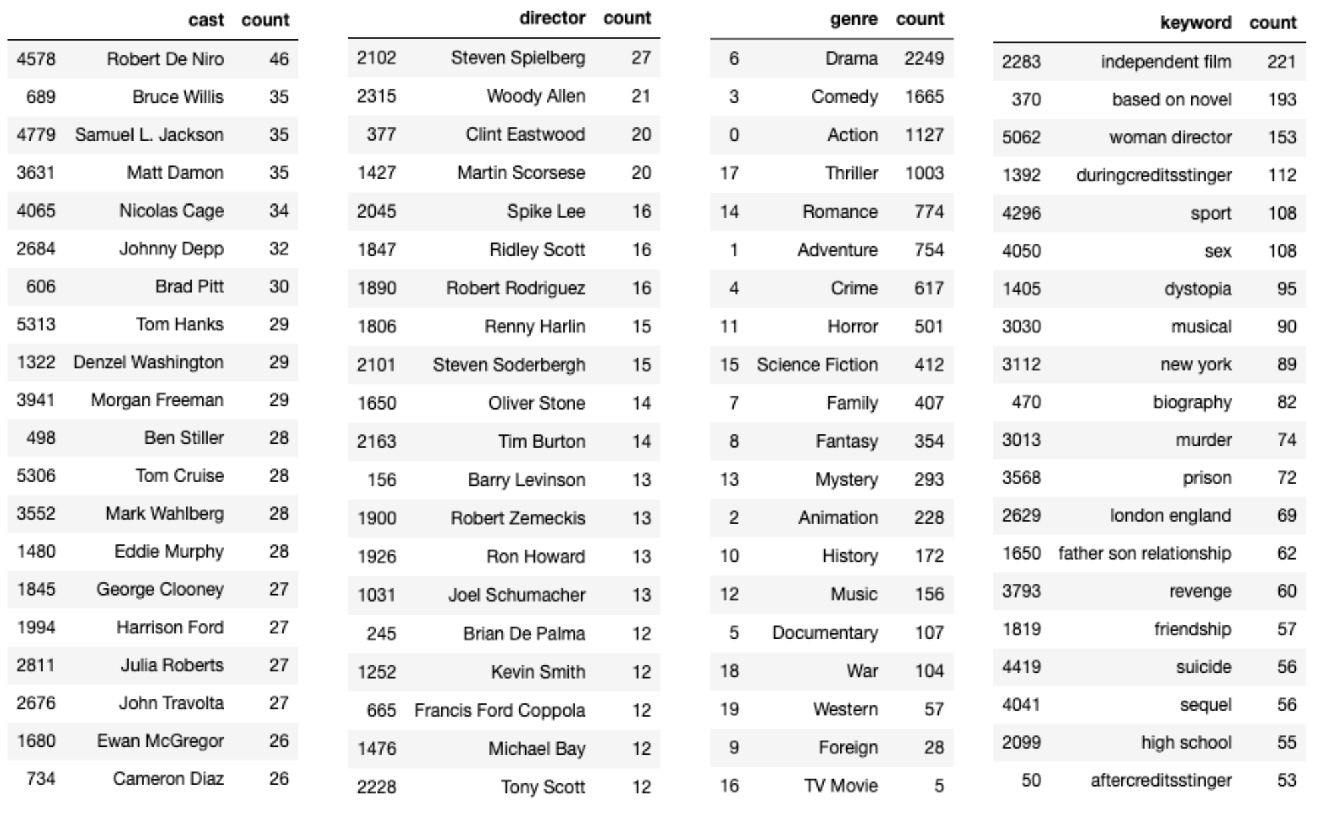
Data Analytics

Slide 16
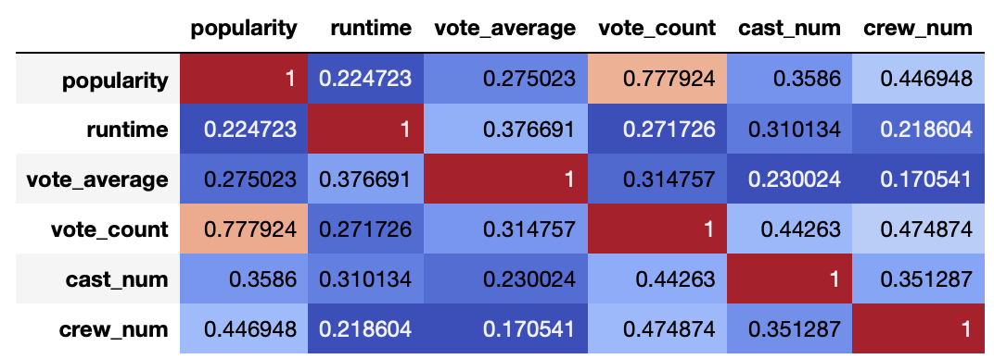
Data Analytics

Slide 17
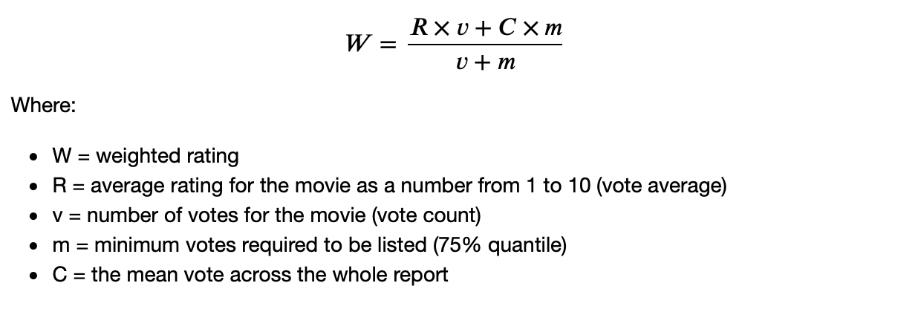
Data Analytics

Slide 18
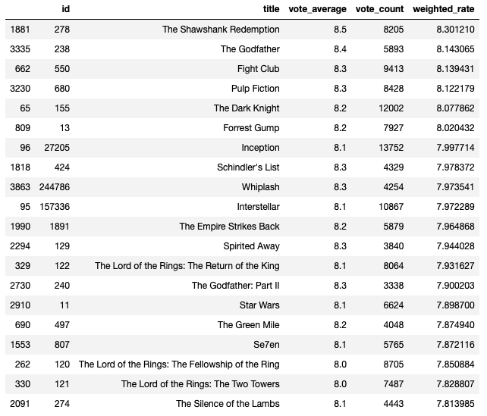
Data Analytics

Slide 19

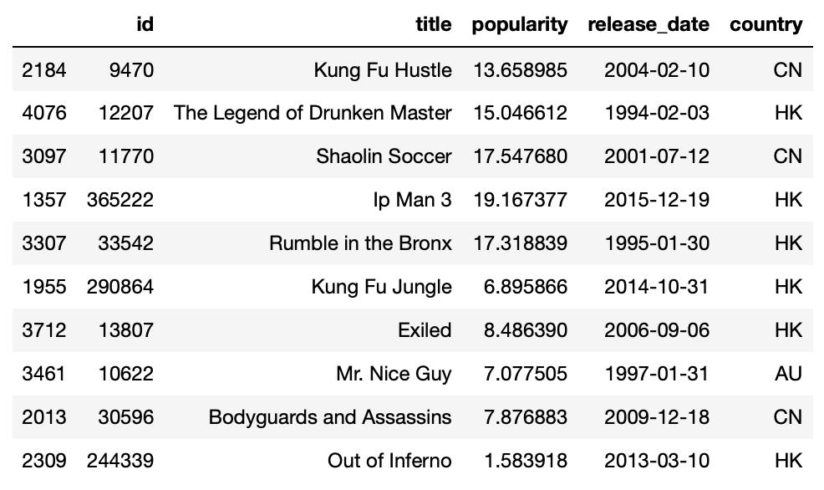
Recommendation

Slide 20
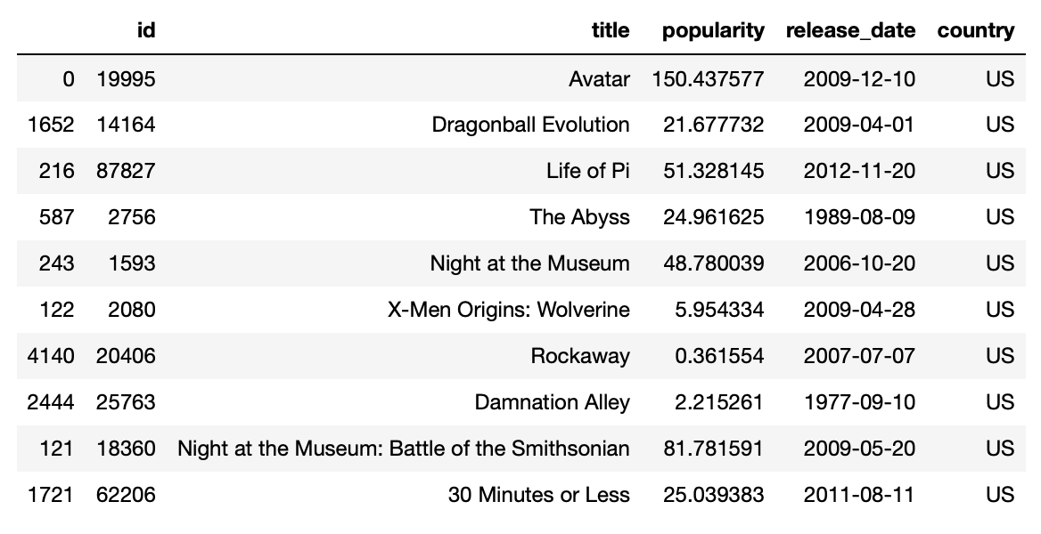

Recommendation

Slide 21

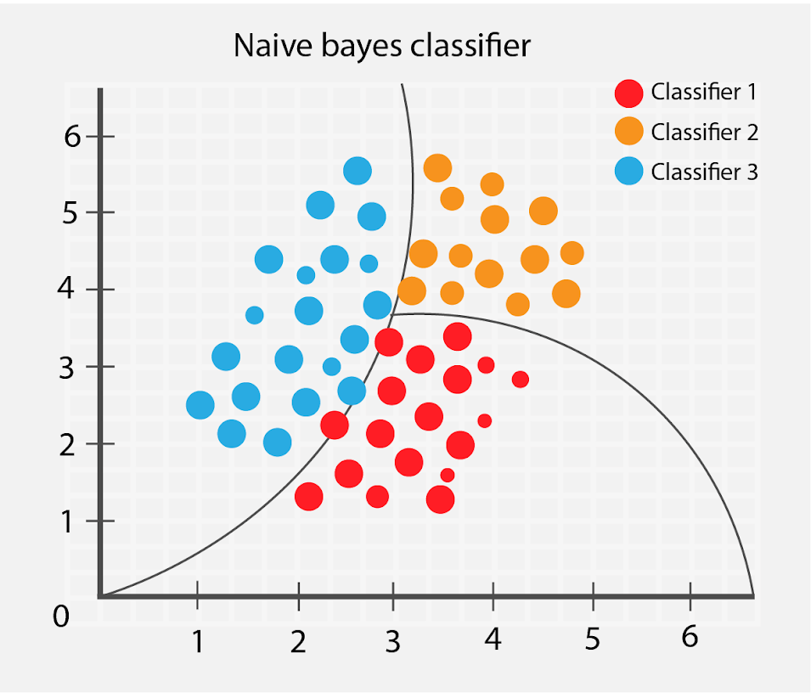
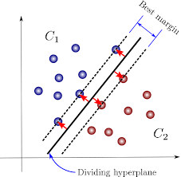
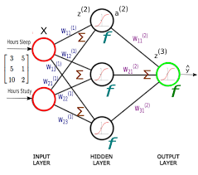
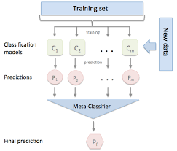
Classification-Classifiers
language cast_0 director genre_0 company_0 country cast_num crew_num
popularity
K-Nearest Neighbors Classifiers
Naïve Bayes Classifiers
Support Vector Machines
Artificial Neural Networks
Ensemble Classifiers
Notes:
Among the 29 features selected after pre processing, we select 9 among all as training set. The label class is popularity, in order to predict whether a new movie will be popular or not among reviewers. For test dataset, the popularity is dropped before inputting.
KNN fastest, lower accuracy
ANN & Ensemble & SVM lowest speed while doing the training, but generate much better result compared with others in accuracy
NB time, accuracy in the middle

Slide 22
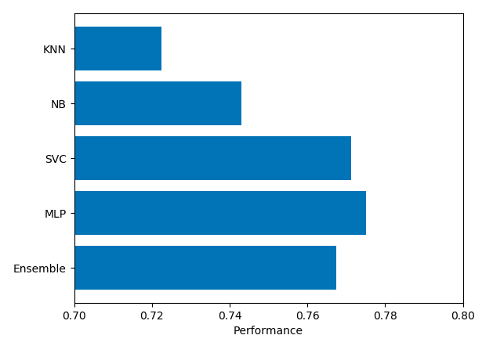
Classification-Performance Metrics
Accuracy Score
Confusion Matrix
Precision
ROC Curve
Self-Define
Notes:
Five metric of performance evaluation have been tried to implement. Here, we take some as example to do demonstration.
For the first one, accuracy score. Can see that svc mlp and ensemble tends to generate a higher accuracy, or say a better performance for this certain dataset we choose

Slide 23
Classification-Performance Metrics
Predicted > Correct v | 0 | 1
0 | 563 | 229
1 | 214 | 590
Predicted > Correct v | 0 | 1
0 | 500 | 292
1 | 118 | 686
Accuracy Score
Confusion Matrix
Precision
ROC Curve
Self-Define
K-Nearest Neighbors
Naive Bayes
Predicted > Correct v | 0 | 1
0 | 587 | 205
1 | 160 | 644
Predicted > Correct v | 0 | 1
0 | 615 | 177
1 | 182 | 622
Predicted > Correct v | 0 | 1
0 | 562 | 230
1 | 141 | 663
Support Vector Machine
ANN
Ensemble
Notes:
Here are confusion matrix for the classifiers. Introduce where represents predicted result, which is the correct label.
Sequence: true negative, false positive, false negative, true positive.
Comparing this five, can find that ANN tends to have a better performance. Since the number of unknown records being classified into true positive and true negative result is larger.
Also some patterns can be observed. For ANN, overall it is better. But Naive Bayes, SVC and Ensemble seems all tend to generate more true or ‘1’, can see the true positive and false positive takes quite large ratio.

Slide 24
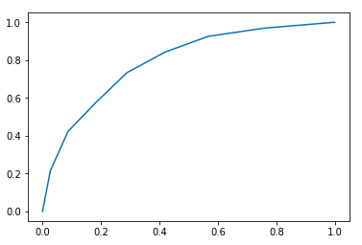
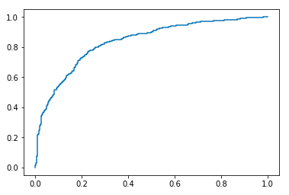
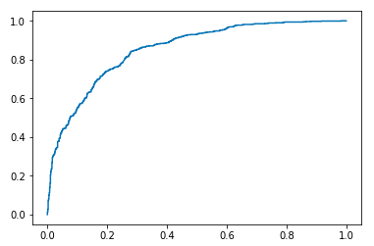
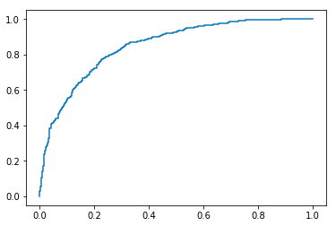
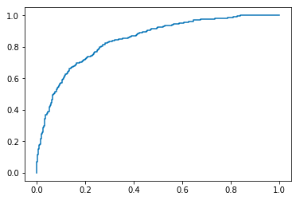
Classification-Performance Metrics
Accuracy Score
Confusion Matrix
Precision
ROC Curve
Self-Define
K-Nearest Neighbors
Naive Bayes
Support Vector Machine
ANN
Ensemble
Notes:
Besides KNN, others are similar and more closer to top left of the graph.

Slide 25
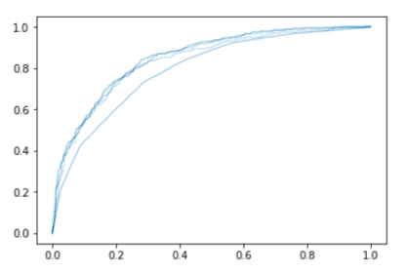
Classification-Performance Metrics
Accuracy Score
Confusion Matrix
Precision
ROC Curve
Self-Define
Combined Curves
Notes:
For these 8 features chosen, and for this certain dataset, KNN tends to have worse performance compared with others, while other classifiers have own defeats or advantages, but the performance doesn’t differ too much. In general, ANN tends to be a better algorithm for new movie prediction.

Slide 26
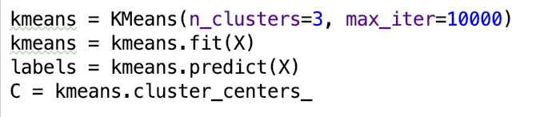
Clustering 1
Method: K-means: imported from sklearn.cluster
Goal: understand the relationships between different attributes, such as popularity, vote count, and vote average.

Slide 27
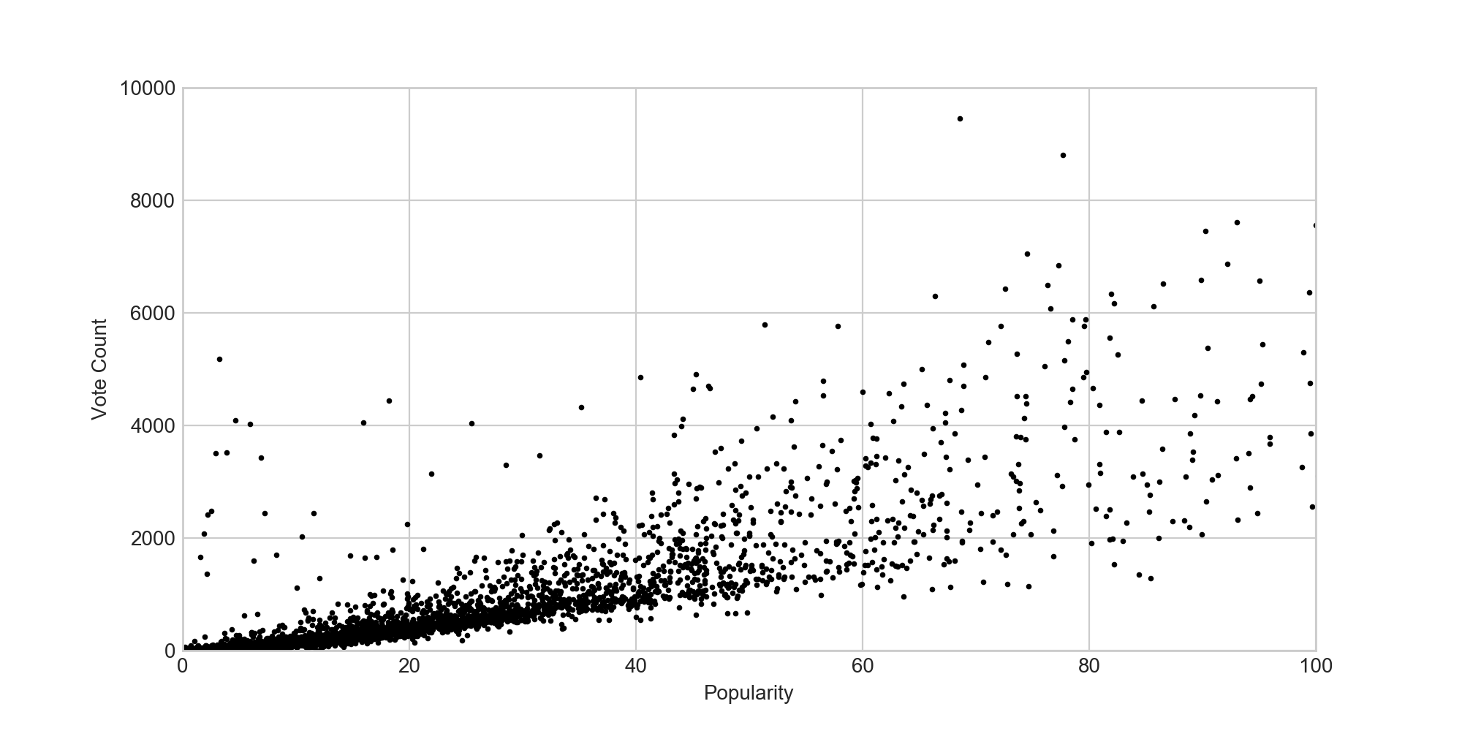
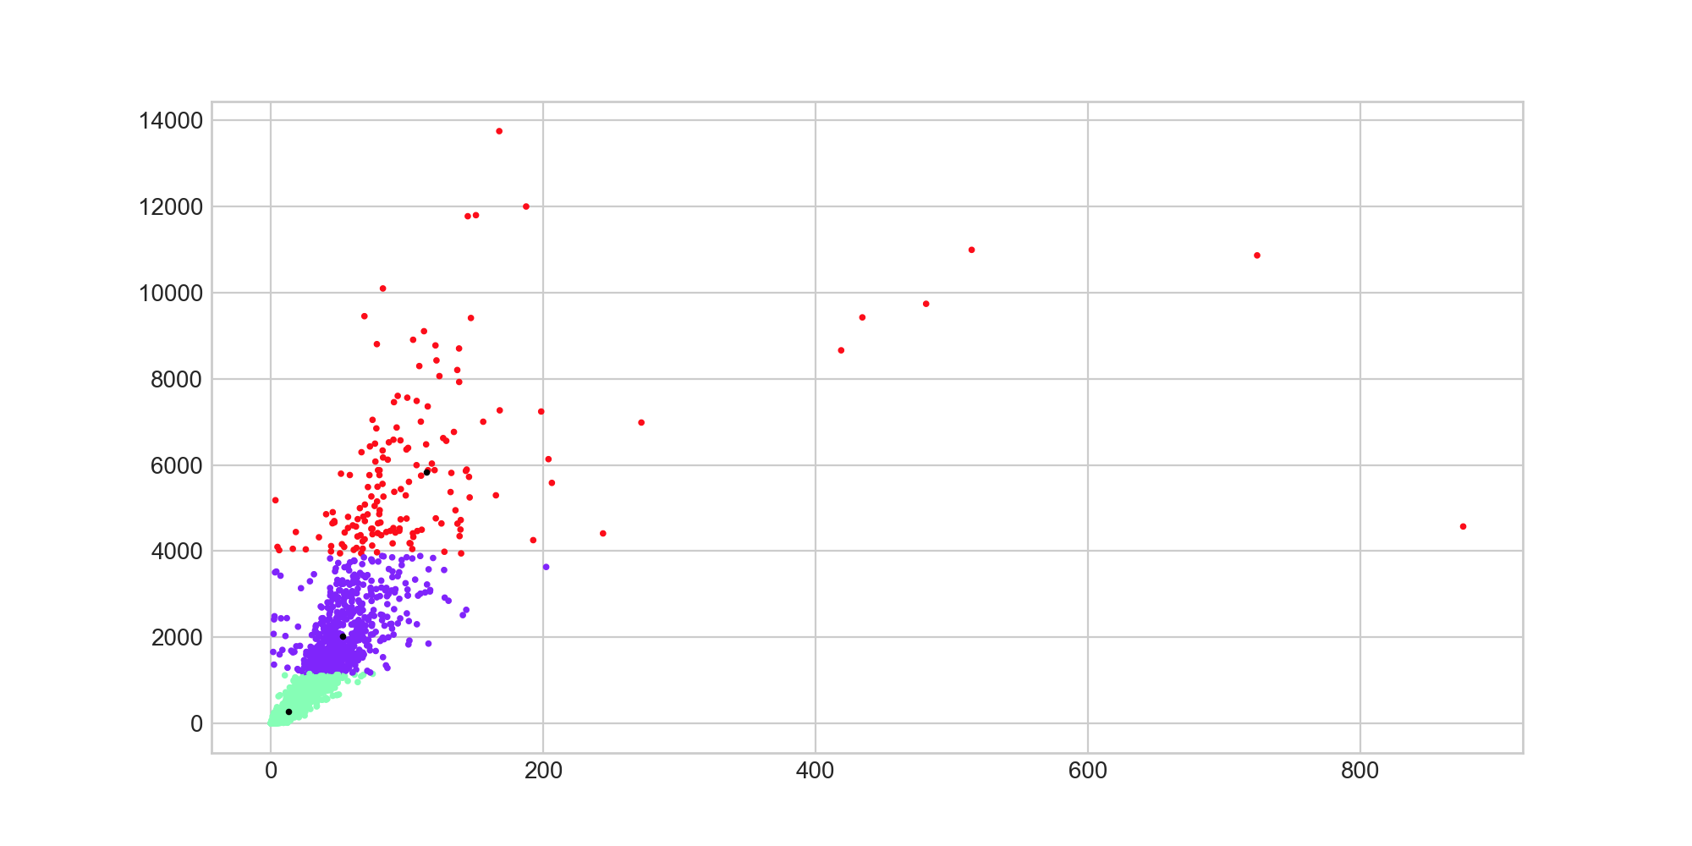
Popularity of movies & Count of votes
k = 3
Notes:
It shows that movies that are less popular are more likely to have less people to vote for them. In other words, people are more willing to vote for popular movies.

Slide 28
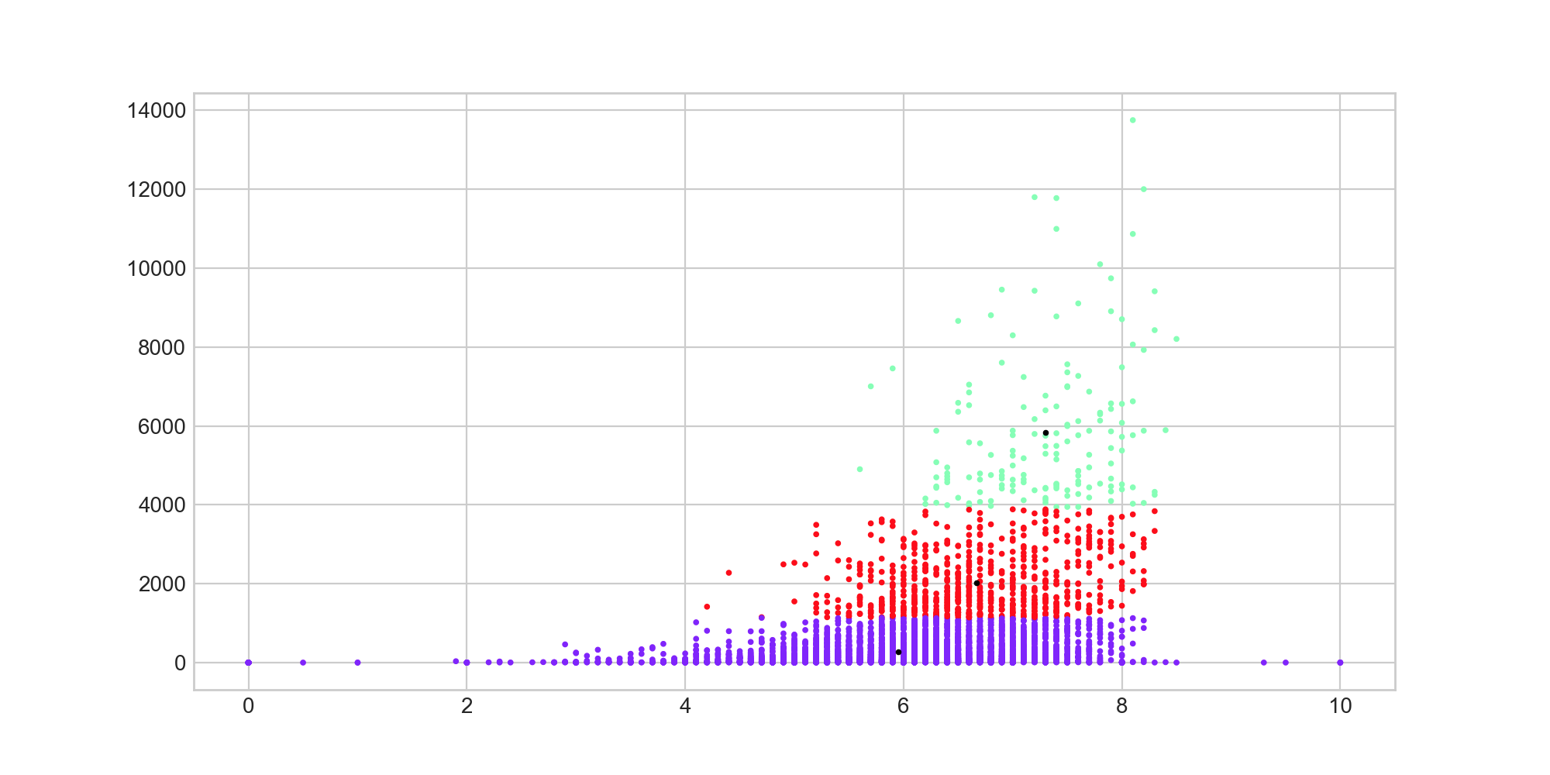
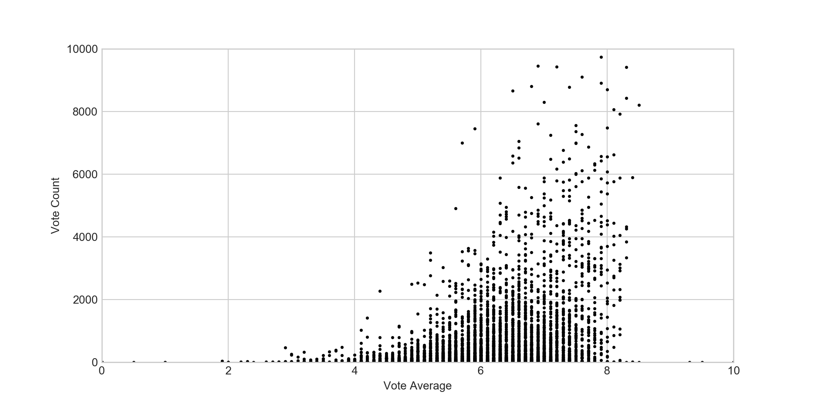
Average vote rates & count of votes
k=3
Notes:
It shows that most movies usually get an average rate of 6 to 8 . And movies with high average rate usually have more votes. In other words, people do not like to vote for those low-rate movies.

Slide 29
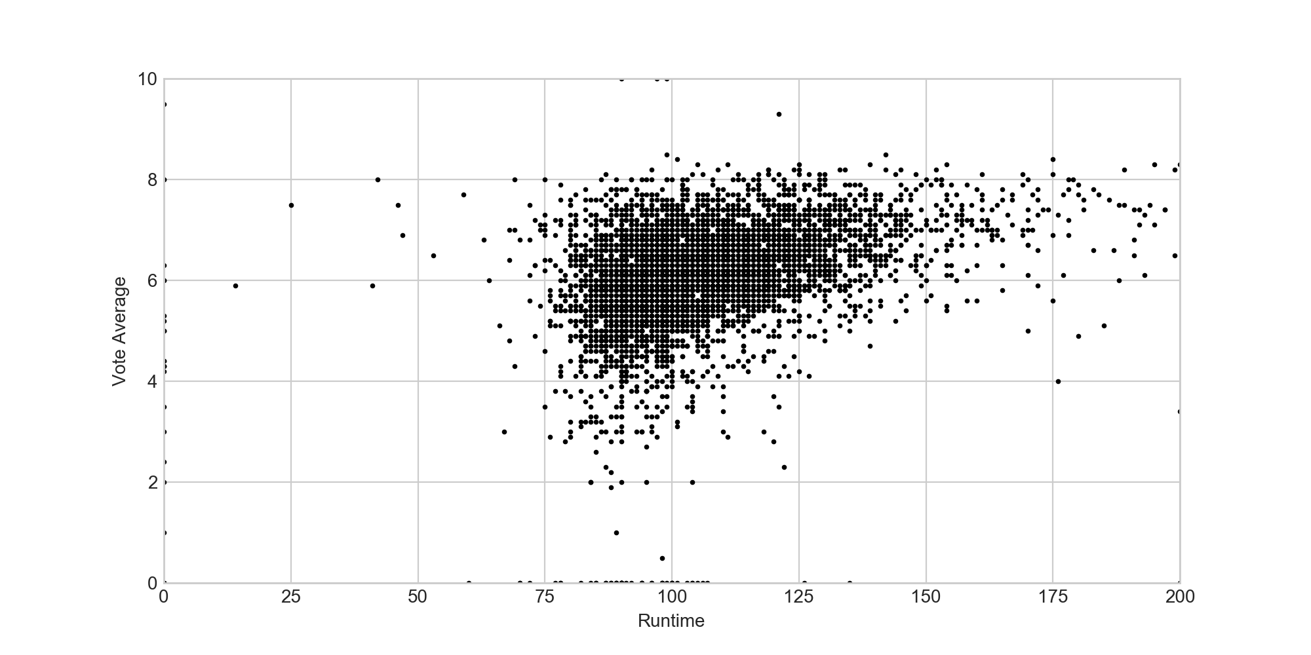
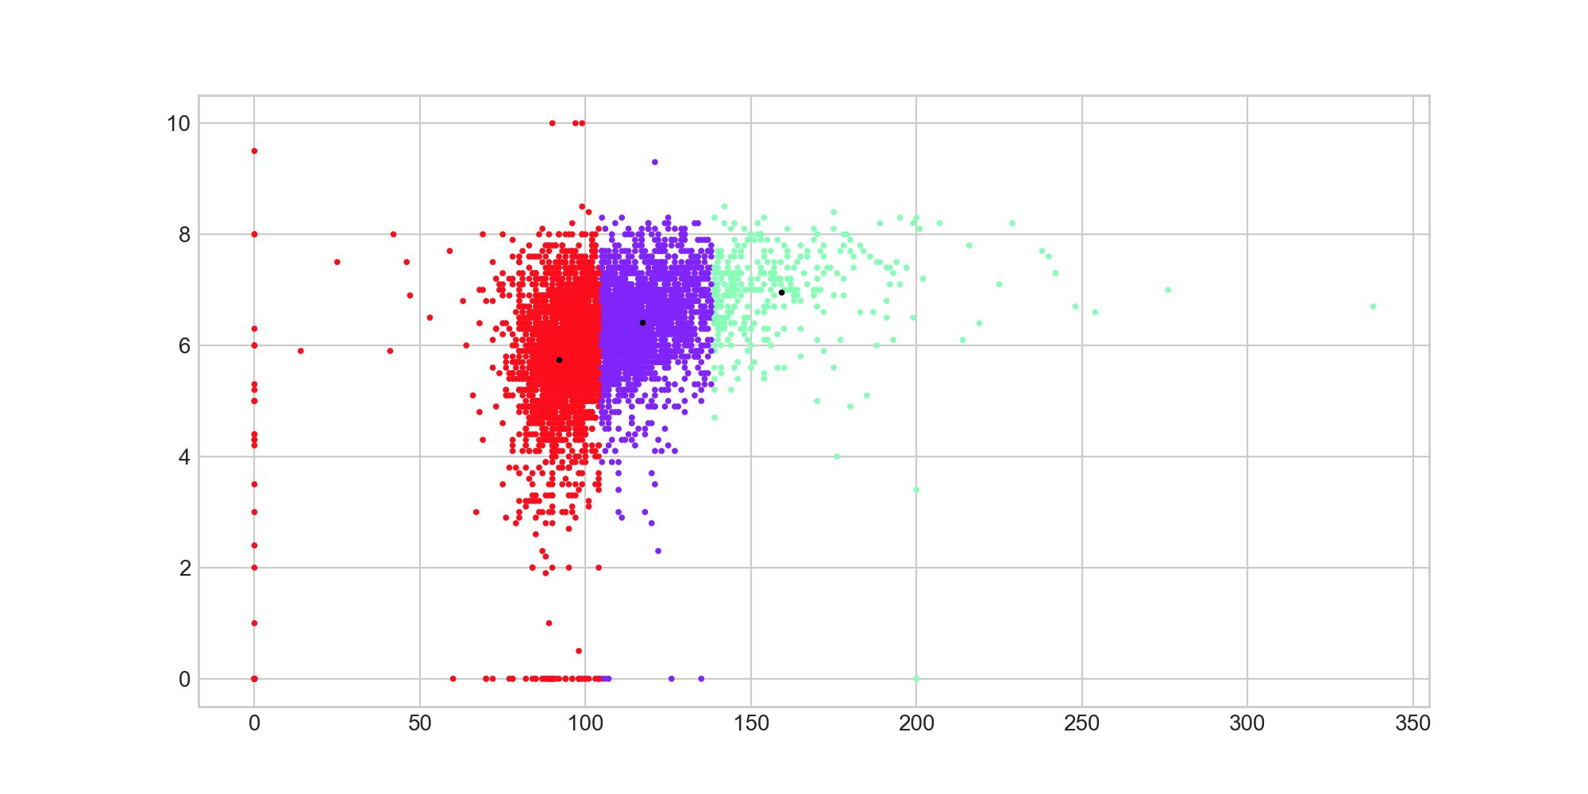
Runtime of movies & average vote rates
k=3
Notes:
There are many outliers on the y-axis and x-axis which should not be considered as final results. When larger number of clusters is chosen, post-processing are required to eliminate small clusters that may represent outliers. The graph shows that no matter what the runtime of movies is, it does not affect their average rates. In other words, there is no evidence showing that longer movies means better movies.

Slide 30
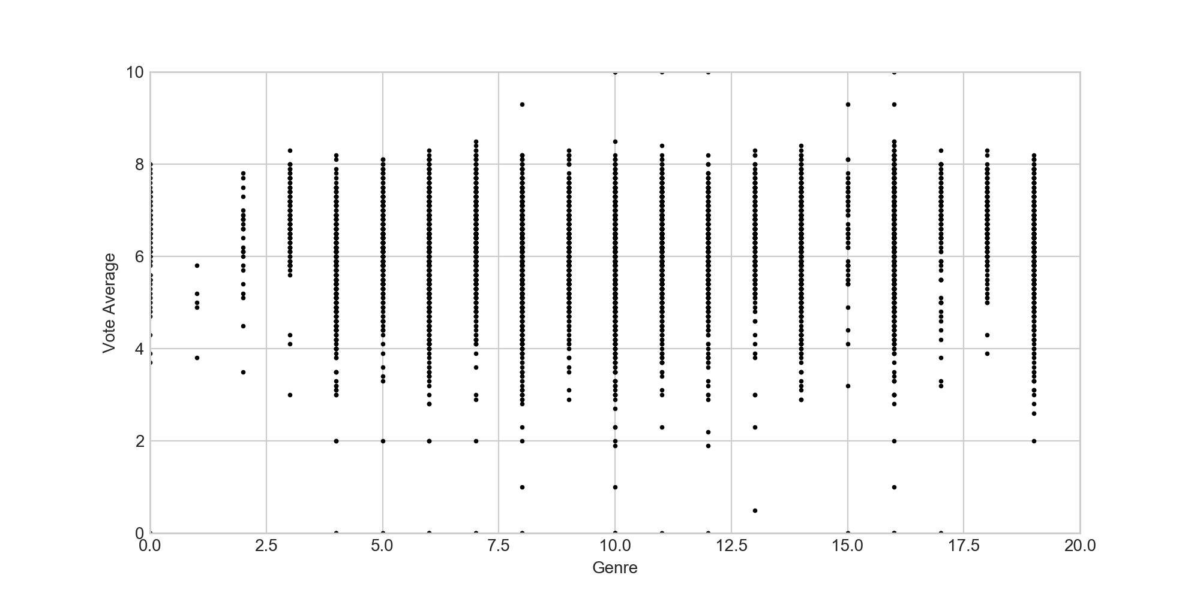
Movie types & average vote rates
First convert types from words to numerical values
Notes:
which is from 0 to 19 and 20 genres in total.

Slide 31
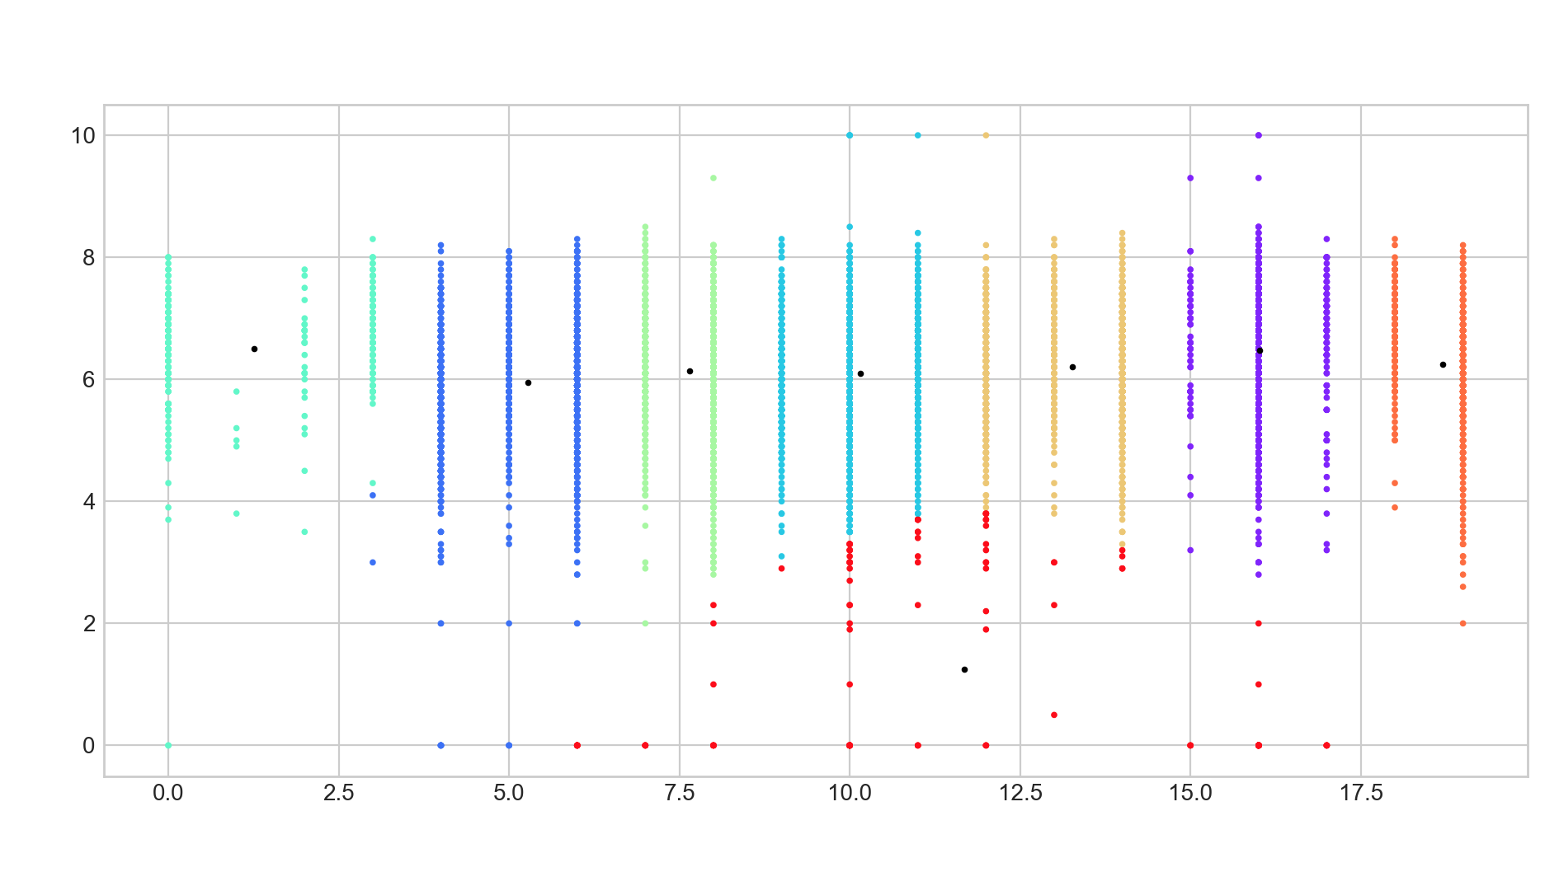
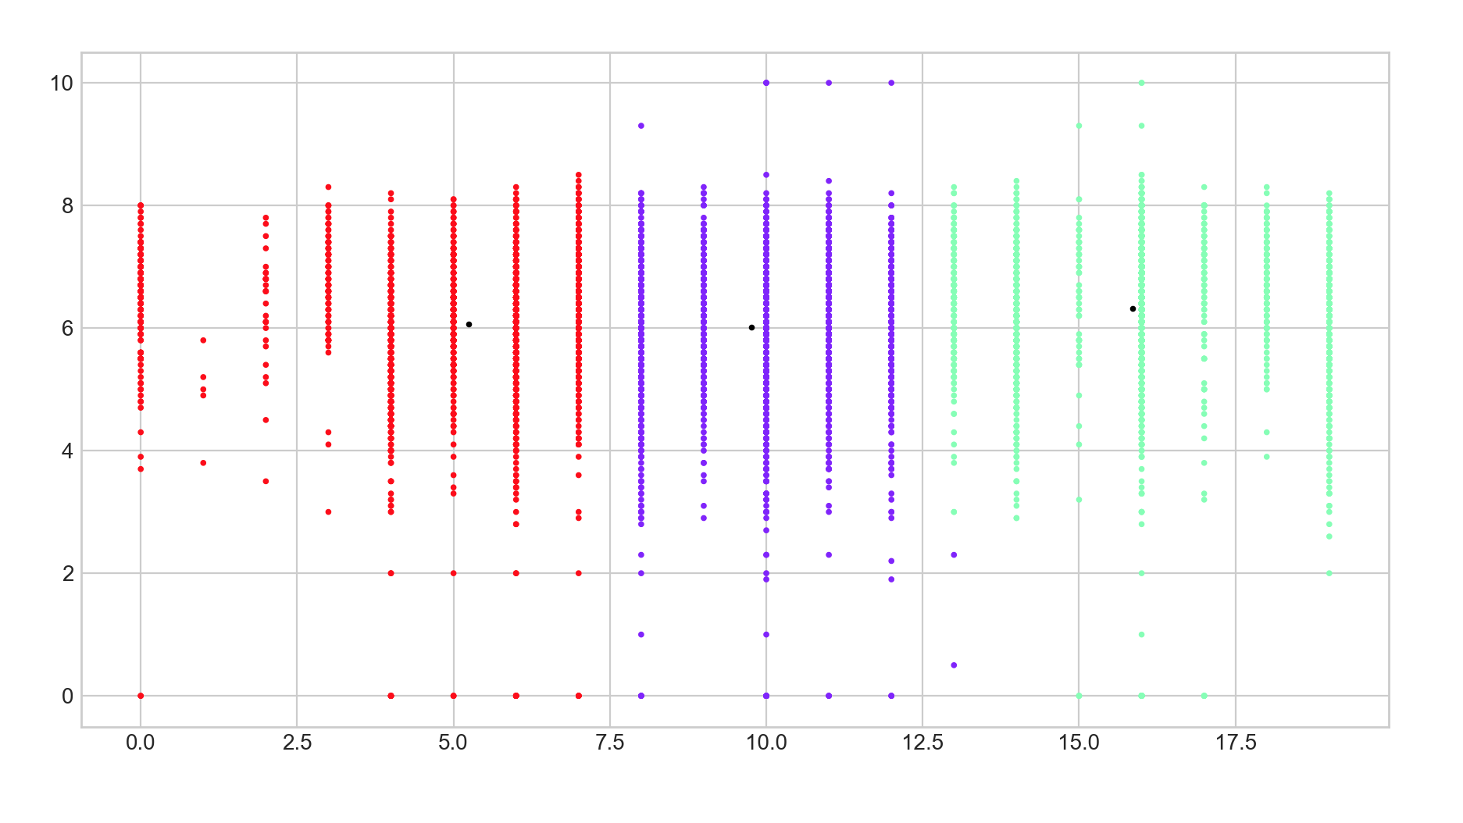
Different number of clusters
k=3 k = 8
Notes:
It shows that when people rate for a movie, there is no preference in the genre of movies. The well-known popular movie types such as action, science fiction, drama and comedy, do not have higher average rate than the movies of minority interest. The movies of minority interest only have less rate, but not lower rate.

Slide 32
Clustering 2- Goals
Goal: trying to solve the problem of understanding the dataset
Try to cluster the dataset to find some relation between those selected attributes
Notes:
The goal of the clustering is to see if we can cluster the data into 2 groups and find some relation with popularity, or if we can cluster the dataset to find some relation between those selected attributes.

Slide 33
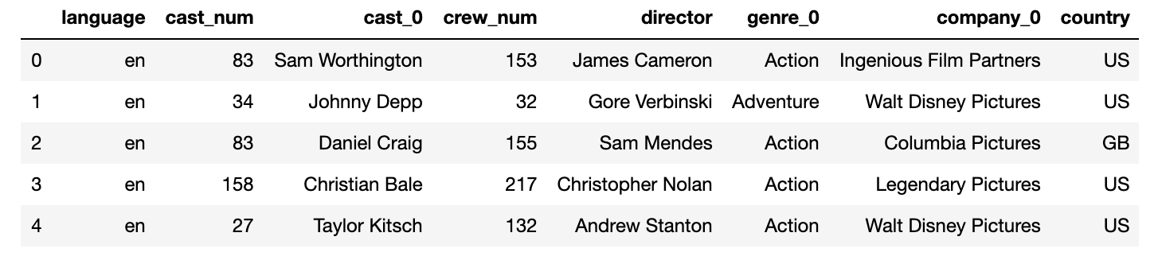
Clustering 2- Data Selection
8 attributes selected
Process them into vector data
Calculate similarity and dissimilarity matrix: SMC = number of matches/number of attributes
Notes:
We selected 8 attributes. Same as the attributes in classifiers, to try to cluster according to values. We process them into vector data. To compute the dissimilarity between two data object, in this case, two nominal vectors, we use Simple Match Coefficient (SMC).

Slide 34
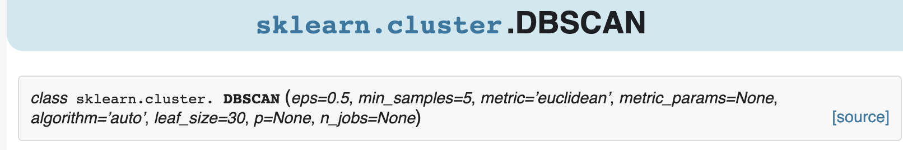
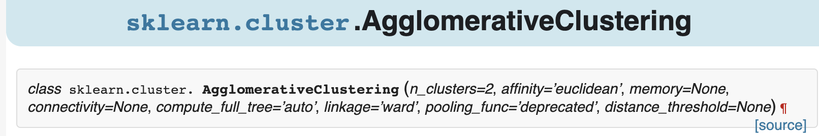
Clustering 2- Algorithm
DBSCAN: density based partition clustering method,
Agglomerative: distance based hierarchical clustering method.
Notes:
DBSCAN and Agglomerative Clustering are two very different clustering methods. DBSCAN is a density based partition clustering method, while Agglomerative Clustering is a distance based hierarchical clustering method.

Slide 35
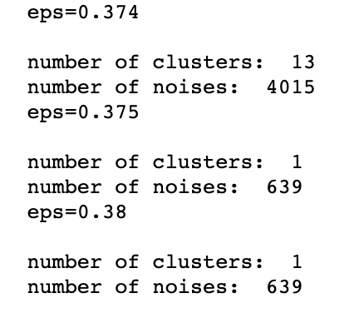
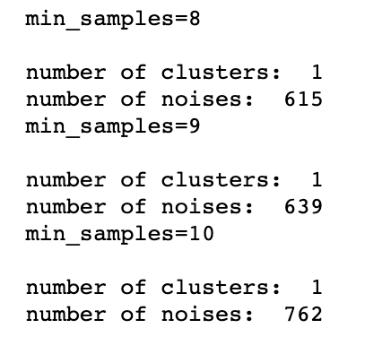
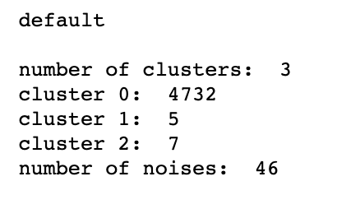
Clustering 2- DBSCAN Result
DBSCAN: self defined (minPoints, eps) , the default of the library is (eps=0.5, min_samples=5)
minPoints = 9 eps = 0.375
Notes:
From the function header, the function requires eps, min_samples and metric. For the dataset used in this project, all of the parameters can be optional expect metrics. In DBSCAN, a low min_sample value means the algorithm will build more clusters from noise points.
There is one heuristic approach, which is using min_samples = n(n), where n is the total number of pointers to be clustered by the algorithm. Then we tried different eps and minPoints to cluster the data, and we only get a lot of noises or single big cluster.

Slide 36
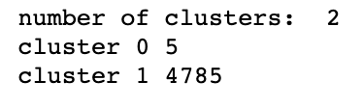

Clustering 2- Agglomerative Result
Agglomerative: distance based hierarchical clustering method.
Notes:
What is printed here is the number of clusters and number of points in each cluster. This is too inconvenient so we visualize it.

Slide 37



Clustering 2- Agglomerative Result
Agglomerative: distance based hierarchical clustering method.
Notes:
What is printed here is the number of clusters and number of points in each cluster. We visualize the size of clusters when the number of clusters are high. As we can see, we only get several more reasonable size of clusters when the number of clusters are really high. Why is that we cannot get reasonable size of clusters?

Slide 38
Clustering 2- Analysis and Future improvement
Probable Reasons:
1. The relation between the data points on these columns are not clear enough to be clustered into some reasonable result.
2. The data pre-processing is not enough. To solve this problem, more columns should be added into the analysis, and we should try different combinations of the selected 29 columns.
3. The algorithm chosen might affect the result.
Notes:
DBSCAN might not be a good clustering method on this dataset because it is very likely to have varying densities. After adding more attributes into the clustering analysis and achieve some more reasonable results, to improve the accuracy and explore relations, different algorithms could be implemented, such as SNN and Jarvis-Patrick.

Slide 39

Association Rule

Slide 40
Summary
Recommend movies based on their similarity
Data Analytics
Predict the success of a movie before released
Classification
Understand the correlation between cast, crew, popularity, vote rate and other attributes
Clustering Analysis, Association Rule

